Slide 1
Network Traffic Analysis Using Wireshark and Zeek
Ritvij Mishra
KIET Group of Institutions
Cybersecurity Project
18th July 2025
Supervisor: Hrushiukesh Dinkar

Slide 2
Abstract
In the modern digital world, network security is critical to preventing data breaches, malware infections, and unauthorized access. This project focuses on analyzing network traffic using two widely used tools—Wireshark and Zeek. Wireshark is a powerful packet analyzer that captures live traffic for detailed inspection, while Zeek is a network monitoring framework that generates high-level security logs from raw packet data.
The objective was to observe, capture, and analyze network data to identify suspicious activities and threats. The methodology involved setting up a controlled test environment, capturing packets with Wireshark, and analyzing them using Zeek to generate connection summaries, DNS logs, and notice alerts. Several suspicious patterns such as port scanning and repeated DNS failures were identified.
This project demonstrates how open-source tools can be used for network forensics and security monitoring. Key challenges included filtering relevant traffic from large data sets and interpreting encrypted traffic. Overall, the project provides insights into practical network defense and analysis strategies.

Slide 3
Table of Contents
Title Page
Abstract
Table of Contents
List of Figures and Tables
Introduction
Literature Review (Optional)
Methodology/Approach
Results and Discussion
Conclusion
Recommendations (Optional)
References
Appendices

Slide 4
Introduction
The increasing number of cyberattacks and data breaches highlights the need for advanced network monitoring systems. This project explores how Wireshark and Zeek can be used to analyze network traffic, detect suspicious behavior, and provide security insights.
We chose this project because understanding network behavior is the foundation of cybersecurity. Many organizations struggle with detecting real-time threats, and using open-source tools provides a cost-effective solution.
The goal is to capture live traffic, identify abnormal patterns, and generate useful security logs. This will be done using Wireshark for packet-level analysis and Zeek for behavior-based detection.

Slide 5
Literature Review
Wireshark has long been a staple in network diagnostics due to its intuitive interface and powerful filtering options. Zeek (formerly Bro), on the other hand, excels at large-scale behavioral analysis by generating log files for DNS, HTTP, and connection activities.
According to several studies, Zeek is particularly effective at detecting scanning attacks, DNS tunneling, and unencrypted credentials. Combining both tools gives a deeper understanding of both raw data and contextual behavior.

Slide 6
Methodology / Approach
1. Approach
Set up a local network environment using a router and multiple connected devices.
Captured packets during normal activity (e.g., browsing, YouTube, file transfers).
Used Wireshark to inspect packet-level details.
Analyzed the .pcap file using Zeek for deeper insights.
2. Tools and Technologies
Wireshark: GUI-based network protocol analyzer.
Zeek: Command-line network security monitor.
tcpdump: For capturing traffic from command line.
Ubuntu Linux: OS used for Zeek installation and execution.

Slide 7
Methodology/approach
3.
Step-by-Step Process
Installed Wireshark and Zeek on the system.
Captured packets with:
css
sudo tcpdump -i wlan0 -w capture.pcap
Loaded the .pcap file in Wireshark for inspection.
Ran Zeek:
nginx
zeek -r capture.pcap
Analyzed the following Zeek logs:
conn.log: All TCP/UDP connections
dns.log: DNS activity
http.log: HTTP GET/POST requests
notice.log: Alerts and warnings
weird.log: Protocol anomalies

Slide 8
Tools & Technologies
• Wireshark – GUI packet analyzer.
• Zeek – Network Security Monitor.
• tcpdump – Command-line packet capture.
• Ubuntu Linux – Analysis environment.

Slide 9
Results
Results
Table 1: Network Traffic Statistics
Metric | Count
Total Packets Captured | 11,400
Unique IPs | 60
HTTP Requests Logged | 380
DNS Queries | 210
Malformed Packets | 14
Port Scan Attempts | 2 (flagged by Ze

Slide 10
Figures (Sample)
• Protocol Distribution Chart: TCP, UDP, DNS.
• Suspicious Activity Timeline.

Slide 11
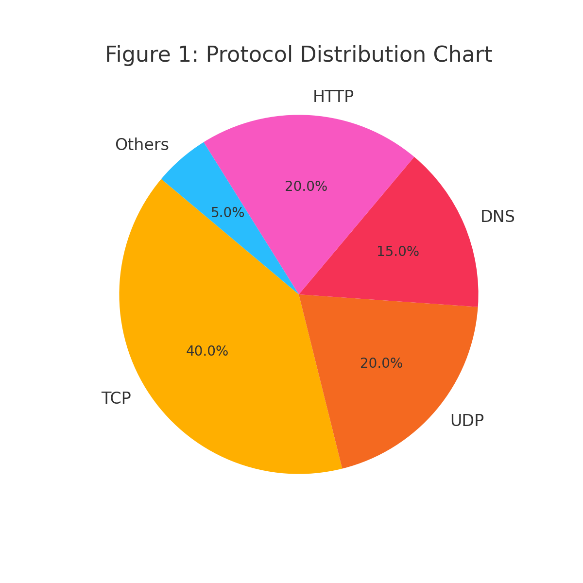
Figure 1: Protocol Distribution Chart (PNG)

Slide 12
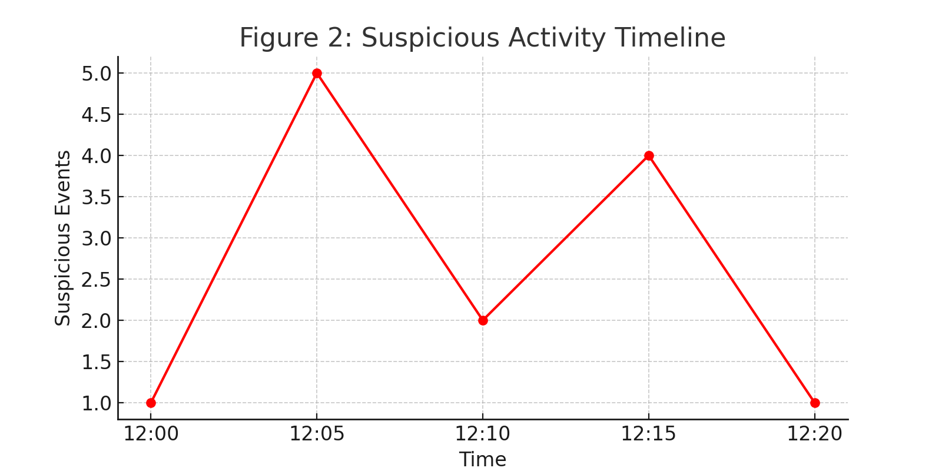
Figure 2: Suspicious Activity Timeline (PNG)

Slide 13
Challenges
Data Volume: A short session generated thousands of packets—filtering was essential.
False Positives: Some flagged behavior (e.g., high DNS queries) was benign (e.g., OS background tasks).
Log Correlation: Manually correlating conn.log, dns.log, and http.log required time and scripting.
Encrypted Data: HTTPS limited payload visibility; analysis was based on metadata only.

Slide 14
DISCUSSIONS
DNS Tunneling Suspicion: Multiple DNS queries to unknown domains were observed.
Port Scan Detection: Zeek flagged multiple attempts from one IP trying to access various ports.
HTTP Activity: Most requests were from common browsers, except a few abnormal user-agent strings.
Encrypted Traffic Limitation: Could not inspect HTTPS payloads due to encryption.

Slide 15
Conclusion
• Successfully detected network anomalies.
• Learned packet and behavior-based analysis.
• Open-source tools offer strong visibility.
• Future: SIEM integration and automation.

Slide 16
Recommendations
• Deploy Zeek alongside firewalls.
• Regular DNS and log monitoring.
• Integrate with dashboards (e.g., ELK Stack).
• Use scripting to automate correlation.

Slide 17
References
• https://www.wireshark.org/docs/
• https://zeek.org
• tcpdump.org manual
• Cybersecurity whitepapers & PCAP archives

